Slide 1

KAPASA MAKASA UNIVERSITY
Research Methods (AA400/ AA300)
Lecture V – Experimental Design
Mrs Sarah Ng’andwe Tembo
Dept of Agric and Aquatic sciences
March 2026

Slide 2
What Is Experimental Design?
Is a structured approach used to conduct scientific experiments.
is the planning process for an experiment. It ensures that the data collected is appropriate and that the conclusions drawn are valid
Experiments are central to the scientific method because they enable researchers test cause–effect relationships

Slide 3
By carefully controlling conditions, researchers can determine whether specific factors cause changes in a dependent variable
The design depends on the objectives of the study. Clear objectives = good design.

Slide 4
Terms in Experimental Design
Treatment: The variable deliberately changed to observe the effect on crops or livestock.
  Example: Fertilizer type, feed type, or clone variety
Experimental Unit: The smallest unit receiving a treatment.
  A single maize plot, vegetable plot, a fish pond, livestock group.
Plot: Another word for an experimental unit.
Block: A group of plots with similar conditions.
Variation: Differences in results caused by treatments or by uncontrolled factors (like weather or genetics).
Experimental Error: Variation caused by unknown or uncontrollable factors. Not arithmetic mistakes, but natural variability

Slide 5
Types of Error
1. Systematic Error: Consistent bias due to faulty equipment or observer habits.
  Example: A weighing scale that is miscalibrated always gives wrong readings. And repeated measurements will not fix this.
2. Random Error: Unpredictable variation due to chance.
  Example: Even though all cows are fed the same type and amount of feed, the daily milk output will vary slightly from cow to cow

Slide 6
Key Details in Designing an Experiment
When planning, researchers must decide on several intermediary details:
1. Variables: Identify the independent variable (the factor you change) and the dependent variable (the outcome you measure).
  Example: Fertilizer type (independent) → maize yield (dependent).
2. Choosing Levels of Variables: Decide the values or categories of the independent variable.
  Example: Fertilizer A, Fertilizer B, Fertilizer C.

Slide 7
3. Experimental Material: Select what you will test on.
  Example: Maize plots, dairy cows, or fish ponds.
4. Manipulation Method: Decide how to apply treatments.
  Example: Apply fertilizer at planting vs. after germination.
5. Recording and Tabulation of Data: Plan how to measure and record results.
  Example: Yield in kilograms per hectare, milk output per cow per day.
6. Mode of Analysis: Choose statistical methods for analysis.
  Example: Use ANOVA to compare yields across fertilizer types.
7. Drawing Inference: Interpret results carefully to make valid conclusions.
  Example: Conclude whether fertilizer A significantly increases yield compared to fertilizer B.

Slide 8
To conduct an experimental study
Two homogenous groups must be identified
One is called the control group and the other is the experimental group
The experimental or treatment group is given the treatment while no treatment is given to the control group
The effects of the treatment are then ascertained by comparing the behavior of the treatment or experimental group with that of the control group

Slide 9
Principles of Experimentation
Almost all experiments rely on three basic principles:
1. Randomization
Randomly assign treatments to experimental units.
This prevents bias and balances unknown factors.
  Example: Randomly assign cows to different diets
  After randomization, any error left in the experiment is due to chance, not bias.
  This is important because random errors can be estimated and controlled statistically, while systematic errors cannot

Slide 10
How to randomize?
Flip a coin
Draw numbers out of a box
Use a random number table
Excel (RANDBETWEEN) function

Slide 11
Principles of Experimentation cont’
2. Replication
means repeating an experiment under identical conditions.
This increases accuracy and reduces the impact of random error.
  Example: Test fertilizer A on 10 plots, not just one.

Slide 12
3. Local Control (Blocking):
Group similar experimental units together to reduce variability.
Example: Group maize plots by soil type before applying treatments, so soil differences do not distort results

Slide 13
Completely Randomized Design
A completely randomized design (CRD) is one where the treatments are assigned completely at random so that each experimental unit has the same chance of receiving any one treatment
It is appropriate only for experiments with homogeneous experimental units, such as laboratory experiments, where environmental effects are relatively easy to control.
The design is intended for experiments where there is no significant variation in the area or environment. As such, CRD is applicable for laboratory or greenhouse experiments

Slide 14
Cont’’
It may also be used for experiments conducted in the open provided the conditions are the same for the entire experiment
  Examples are:
pot or seed flat experiments where the soil is thoroughly mixed.
In animal experiments, the animals should be of the same age, weight, breed, etc.

Slide 15

Layout of CRD
The step-by-step procedure for randomization and layout of a CRD are given here for a pot culture experiment with four treatments A, B, C and D, each replicated five times
  Step 1 Determine the total number of experimental plots (n) as the product of the number of treatments (t) and the number of replications (r); that is, n = rt
  In case the number of replications is not the same for all the treatments, the total number of experimental pots is to be obtained as the sum of the replications for each treatment. i.e.,
  Step 2 Assign a plot number to each experimental plot in any convenient manner; for example, consecutively from 1 to n

Slide 16
Step 3. Assign the plot numbers to the experimental plots using a randomization scheme.
A. Using draw lots.
  Prepare pieces of papers corresponding to the number of experimental units.
  Write the plot number in each of the papers.
  Mix the papers thoroughly in a container.
  Without looking inside the container, draw a paper and assign the plot number on the first experimental unit.
  Suppose T4R1 was drawn first, it will be assigned to the first space in the experimental area

Slide 17
continue drawing individual papers and assign the plot numbers until all the corresponding treatments have been assigned to all experimental unit.

Slide 18
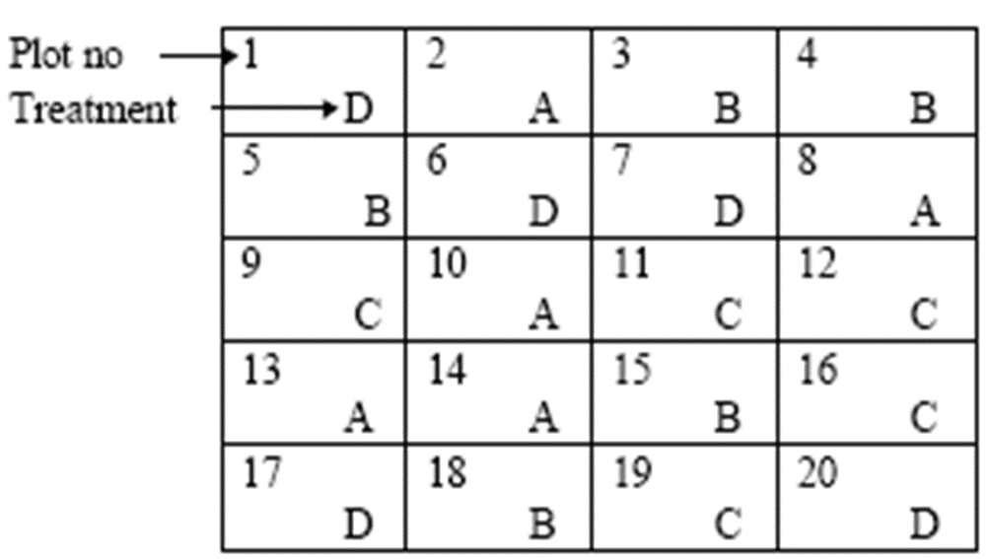
When the randomization is finished, the final layout may look like this

Slide 19
Example
If we have 4 different types of feed to be tested on a cattle breed for its efficacy in terms of weight gain
The feed is a factor
  4 types of feed are 4 treatments (A,B,C,D)
For this experiment we have 20 cattle of the same breed, similar age group, and belonging to a particular sex
Uniformity of the cattle assures the homogenous nature of the experimental material

Slide 20
Randomized Complete Block Design (RCBD)
Experiments in the open field is conducted using Randomized Complete Block Design (RCBD) because it is difficult to totally control the condition in the experimental area.
Variation in the condition of the area may be due to the soil itself (fertility, soil type), slope or gradient, wind direction, water direction, presence (or absence) of disease and insect pests, etc.
Because of these uncontrolled factors, Completely Randomized Design is not applicable. With RCBD, blocking is introduced which will help reduce (not totally eliminate) the effect of the uncontrolled factors.

Slide 21
Blocking Technique
The purpose of blocking is to reduce the experimental error by eliminating the contribution of known sources of variation among the experimental units
This is done by grouping the experimental units into blocks such that variability within each block is minimized and variability among blocks is maximized
An ideal source of variation to use as the basis for blocking is one that is large and highly predictable
    An example is soil heterogeneity, in a fertilizer or provenance trial where yield data is the primary character of interest
Whenever blocking is used, the identity of the blocks and the purpose for their use must be consistent throughout the experiment

Slide 22
Difference between CRD and RCBD
The basic difference between CRD and RCBD is the presence of blocks in RCBD. In CRD,
randomization is done in the whole experimental area while in RCBD, randomization is done in
each block and each randomization is independent of the other. Since randomization is done in
each block, all treatments should appear in each block (or each treatment should appear only
once in each block).

Slide 23
Layout
In randomization and layout, two important decisions have to be made in arriving at an appropriate and effective blocking technique:
  • The selection of the source of variability to be used as the basis for blocking (soil, fertilizer type, slope in the field.
  • The selection of block shape and orientation.

Slide 24
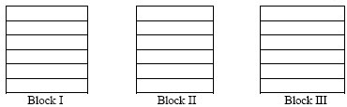
Layout
The randomization process for a RCBD is applied separately and independently to each of the blocks
  The procedure is illustrated for the case of a field experiment with six treatments A, B, C, D, E, F and three replications
  Step1. Divide the experimental area into r equal blocks, where r is the number of replications

Slide 25
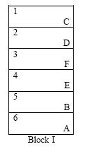
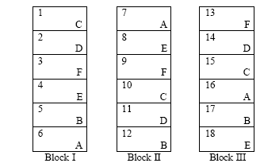
Layout conts’
  Step 2.. Subdivide the first block into t experimental plots, where t is the number of treatments
  Number the t plots consecutively from 1 to t, and assign t treatments at random to the t plots following any of the randomization schemes for the CRD
  Step 3. Repeat Step 2 completely for each of the remaining blocks

Slide 26
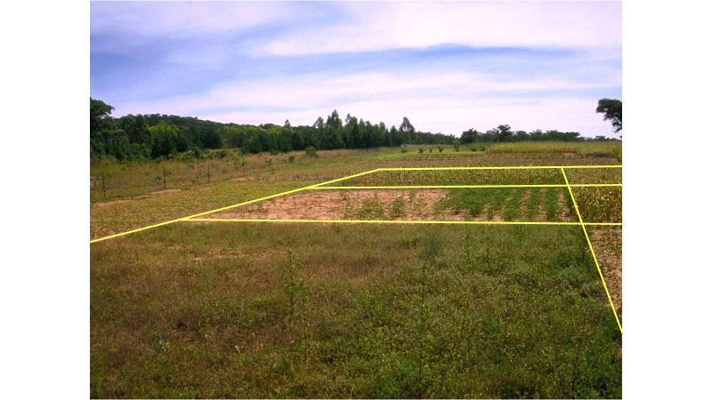

Slide 27
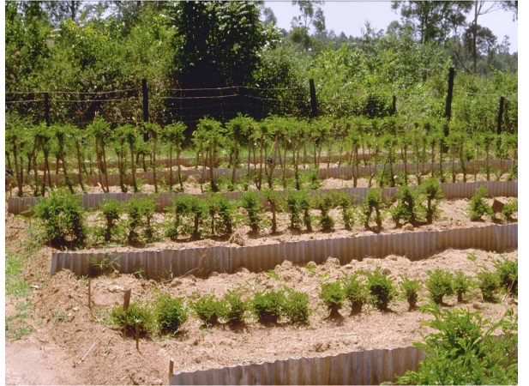

Slide 28
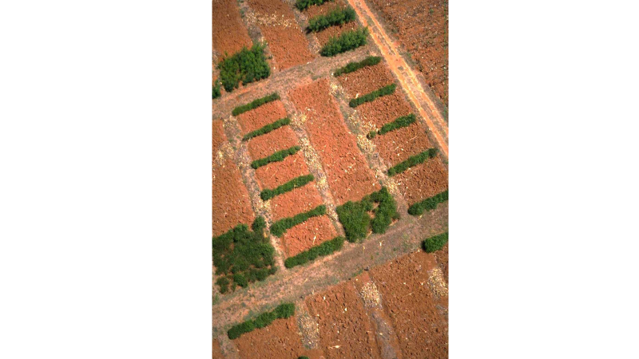

Slide 29
Reading assignment
Read more on the following;
1. Latin square designs
2. Factorial experiments
3. Split plot

